Slide 1
Chapter 3 – Computational optimization of the elastic wave-equation Reciprocity in multicomponent data

Slide 2
Chapter 3 – Reciprocity

Slide 3
Chapter 3 – Reciprocity
Wave-based methods model shots individually.

Slide 4
Chapter 3 – Reciprocity
# of shots: ~10³ to 10⁵
# of nodes: ~10²

Slide 5
Chapter 3 – Reciprocity
Wave-based methods model shots individually.
So, would swapping sources and receivers be advantageous?
Modeling in the receiver domain can be computationally cheaper than in the shot domain.

Slide 6
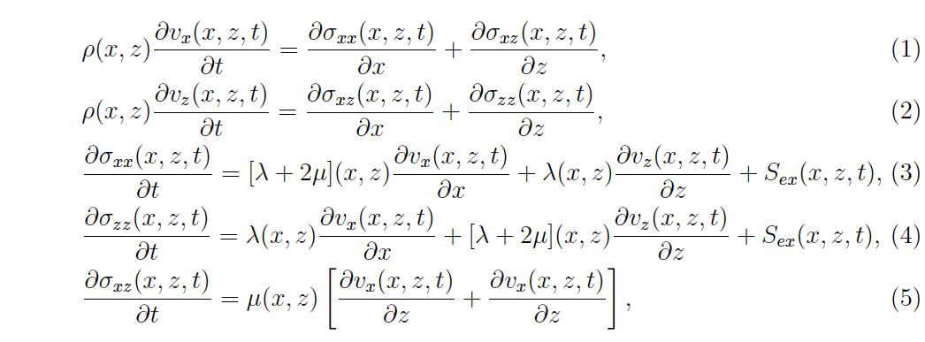
Chapter 3 – Equivalence of stress and velocity sources
Equivalence between stress and velocity sources

Slide 7
Chapter 3 – Equivalence of stress and velocity sources
Equivalence between stress and velocity sources
airgun source

Slide 8
Chapter 3 – Equivalence of stress and velocity sources
Equivalence between stress and velocity sources
Pressure
(hydrophone data)
airgun source

Slide 9
Chapter 3 – Equivalence of stress and velocity sources
Equivalence between stress and velocity sources
Particle
Velocities
(geophone data)
?
Pressure
(hydrophone data)
airgun source

Slide 10
Chapter 3 – Equivalence of stress and velocity sources
Equivalence between stress and velocity sources
?
airgun source

Slide 11
Chapter 3 – Equivalence of stress and velocity sources
Equivalence between stress and velocity sources
?
airgun source

Slide 12
Chapter 3 – Equivalence of stress and velocity sources
This is equivalent to integration by parts which is usually done in earthquake seismology.
V_{z}
+
+
σ_{xx}, σ_{zz}
V_{x}
+
-
V_{x}
-
V_{z}
12

Slide 13
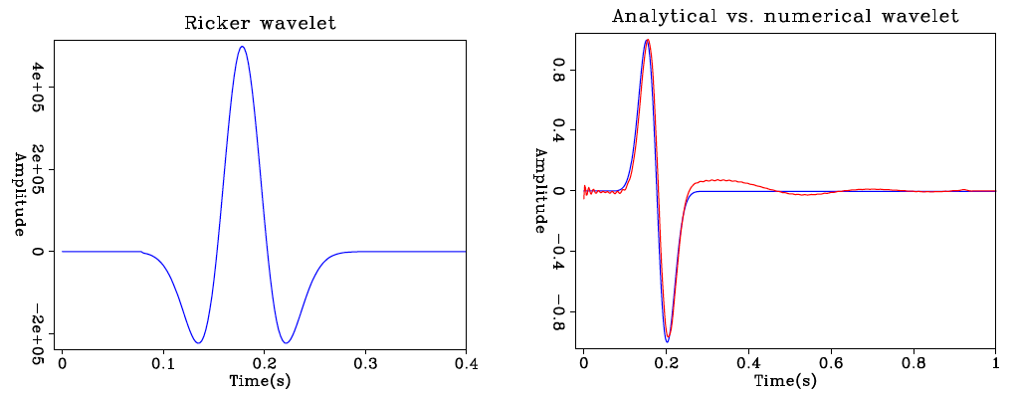
Chapter 3 – Equivalence of stress and velocity sources
Analytical solution
Inverted solution
V_{z}
+
+
σ_{xx}, σ_{zz}
V_{x}
+
-
V_{x}
-
V_{z}

Slide 14
Chapter 3 – Spatial reciprocity
In a linearly elastic medium, the particle displacement in i-th direction at point B due to a force in the j-th direction at A is equivalent to the particle displacement at A in the j-th direction due to a force at B in the i-th direction.

Slide 15
Chapter 3 – Spatial reciprocity
In a linearly elastic medium, the particle displacement in i-th direction at point B due to a force in the j-th direction at A is equivalent to the particle displacement at A in the j-th direction due to a force at B in the i-th direction.

Slide 16
Chapter 3 – Spatial reciprocity
In a linearly elastic medium, the particle displacement in i-th direction at point B due to a force in the j-th direction at A is equivalent to the particle displacement at A in the j-th direction due to a force at B in the i-th direction.
receiver in i-th
receiver in j-th
receiver at B
receiver at A
source at A
source at B
force in j-th
force in i-th

Slide 17
Chapter 3 – Spatial reciprocity - hydrophone
The forward problem:
V_{x} + V_{z}
σ_{xx} + σ_{zz}

Slide 18
Chapter 3 – Spatial reciprocity - hydrophone
The reciprocal problem:
σ_{xx} + σ_{zz}
V_{x} + V_{z}

Slide 19
Chapter 3 – Spatial reciprocity - geophone
The forward problem:
V_{x} + V_{z}
V_{x}
V_{z}

Slide 20
Chapter 3 – Spatial reciprocity - geophone
The reciprocal problem:
V_{x}
V_{z}
V_{x} + V_{z}

Slide 21
Chapter 3 – Spatial reciprocity - geophone
The reciprocal problem:
V_{x}
V_{z}
V_{x} + V_{z}

Slide 22
Chapter 3 – Spatial reciprocity - geophone
The reciprocal problem:
force in x
force in x
force in z
force in z

Slide 23
Chapter 3 – Spatial reciprocity – Horizontal geophone
The reciprocal problem:
V_{x} +V_{z}
V_{x}

Slide 24
Chapter 3 – Spatial reciprocity – Vertical geophone
The reciprocal problem:
V_{x} +V_{z}
V_{z}

Slide 25
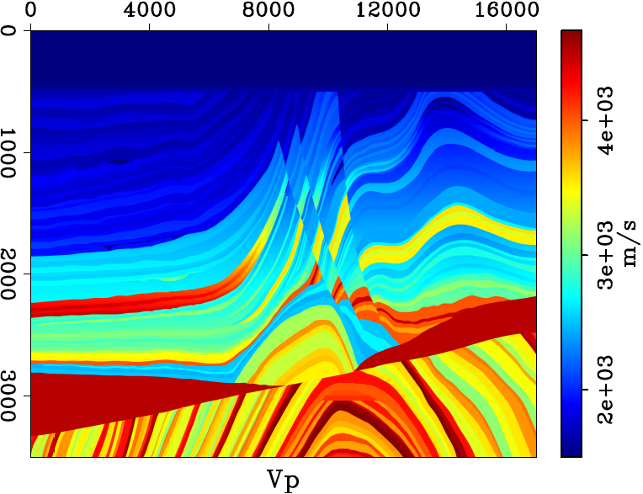
Chapter 3 – Spatial reciprocity – Synthetic example

Slide 26
Chapter 3 – Spatial reciprocity – Synthetic example
Direct
Reciprocal

Slide 27
Chapter 3 – Spatial reciprocity – Synthetic example
Direct
Reciprocal

Slide 28
Chapter 3 – Spatial reciprocity – Synthetic example
Direct
Reciprocal

